Slide 1
IWA Water and Development Congress & Exhibition 2025
8-12 December 2025 | Bangkok – Thailand
Life cycle assessment and economic evaluation of regenerable adsorbent-based arsenic removal
Dr Károly Kovács PhD (oec), chairman of the Hungarian Water Partnership

Slide 2
WHAT COSTS MUST BE PAID during operation?
with 5% discount rate?

Slide 3
cost comparisons of arsenic removal technologies
Based on total life-cycle costs!!!!
30 years

Slide 4

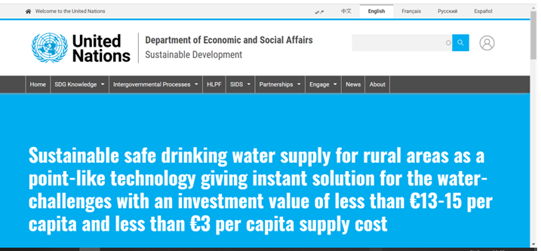
Messages
If you want:
to have regulatory compliant, cost-efficient, resilient projects with long-term performance
to ensure economic and operational sustainability
You need :
strategic planning, proper project preparation
to identify cost-efficient, and economically viable solutions
with the lowest operational costs
Which one to choose?
4,64 euro cent /m³ – or 18,78 euro cent/m³???
https://sdgs.un.org/partnerships/sustainable-safe-drinking-water-supply-rural-areas-point-technology-giving-instant

